Slide 1
Explainable Multi-Class Chest X-Ray Disease Classification Using ConvNeXt And RepViT
Under the Guidance of ,
Mr. K. Rajasekhar
Sr. Asst Professor
V.Sri lakshmi keerthi(23761A1266) P.Niveditha(23761A1240)
V.Uma maheswara rao(23761A1265)

Slide 2
Outline
Abstract
Literature Survey
Existing System
  Disadvantages
Proposed System
Advantages
Proposed Architecture
Dataset
System Design
Implementation
References

Slide 3
Abstract
Chest X-rays are widely used to diagnose respiratory diseases, but manual diagnosis is time-consuming and depends on expert radiologists. This project proposes an explainable multiclass deep learning framework using U-Net for lung segmentation and ConvNeXt with RepViT for feature extraction. The system classifies chest X-rays into Normal, Viral Pneumonia, COVID-19, and Lung Opacity. Grad-CAM provides visual explanations of the predictions.

Slide 4
Literature Survey
Paper | Models Used | Year | Merits of the work | Demerits of the work | Dataset used | Name of the Journal
An intelligent decision support framework for automated pneumonia classification from chest X-ray images using hybrid vision transformers and CNNs | MSAF-Net and DAR-Net, combining CNN and Vision Transformer with attention-based feature fusion | 2026 | Combines CNN and Transformer features; improves feature discrimination; reduces model complexity; DAR-Net achieved 81.75% balanced accuracy and 0.9521 AUC. | DAR-Net has high computational requirements and the study lacks extensive ablation of basic hybrid models | 5,200 chest X-ray images containing COVID-19, lung opacity,Normal and Pneumonia | Intelligence-Based Medicine

Slide 5
Paper | Models Used | Year | Merits of the work | Demerits of the work | Dataset used | Name of the Journal
Improving pneumonia diagnosis with high-accuracy CNN-Based chest X-ray image classification and integrated gradient | InceptionV3-based CNN with Integrated Gradients for explainability | 2025 | Provides high classification accuracy and visual explanation of important image regions | Binary classification and a relatively large model with 22.9 million trainable parameters | 5,856 chest X-ray images containing Normal and Pneumonia | Biomedical Signal Processing and Control
Enhanced pneumonia prognosis via a hybrid deep learning ensemble: Dense Net, Efficient Net, and VGG16 integration | DenseNet, EfficientNet, VGG16, InceptionV3, Bayesian Optimization and Particle Swarm Optimization | 2026 | Ensemble learning improves performance and BO-PSO provides optimized hyperparameters; achieved 99.23% accuracy | Binary classification and increased computational complexity due to ensemble and optimization | 5,856 chest X-ray images containing Normal and Pneumonia | Computational Biology and Chemistry

Slide 6
Existing System
The existing system uses hybrid ViT and CNN models, namely MSAF-Net (ViT + EfficientNetB0) and DAR-Net (ViT + ResNet50), to classify chest X-ray images.
Disadvantages
No explicit lung-region segmentation
High computational complexity
Complex hybrid architecture

Slide 7
Proposed System
The proposed system uses U-Net to segment the lung region from the chest X-ray image.
The segmented image is processed by ConvNeXt and RepViT to extract complementary deep features.
The extracted features are fused and classified into Normal, Viral Pneumonia, COVID-19 and Lung Opacity using a Dense classifier.
Grad-CAM generates heatmaps to explain the model's predictions.

Slide 8
Advantages
Supports multiclass disease classification.
Uses U-Net for lung region segmentation.
Combines ConvNeXt and RepViT for better feature extraction.
Provides explainable predictions using Grad-CAM.

Slide 9
Proposed Architecture
1. Chest X-ray dataset
4 classes
2. Preprocessing
Resize + normalize
3. U-Net segmentation
Lung region extraction
6. Grad-CAM
Visual explanation
5. Classification
4-class prediction
4. ConvNeXt + RepViT
Feature extraction and fusion

Slide 10
Dataset
COVID-19 Radiography Database
A publicly available Kaggle collection of chest X-ray images with ground-truth lung masks, used for COVID-19 and pneumonia classification with deep learning.
Dataset Details
Image Type: Chest X-ray images (PNG, 299 × 299) with lung masks(256 x 256)
Total Images: 21,165 (balanced subset used: 5,380)
Classes: 4
  Normal
  Covid-19
  Lung opacity
  Viral pneumonia
Dataset link - https://www.kaggle.com/datasets/tawsifurrahman/covid19-radiography-database

Slide 11
System Design
Preprocess
Resize 224 × 224
Normalize
U-Net
Lung segmentation
Dice 98.08%
Dual Backbone
ConvNeXt-Tiny (768-d)
RepViT-M1 (384-d)
Classifier
Concat 1152-d
Dense head, 4 classes
Grad-CAM
Lung heatmaps
Explainability
Class + probability + heatmap

Slide 12
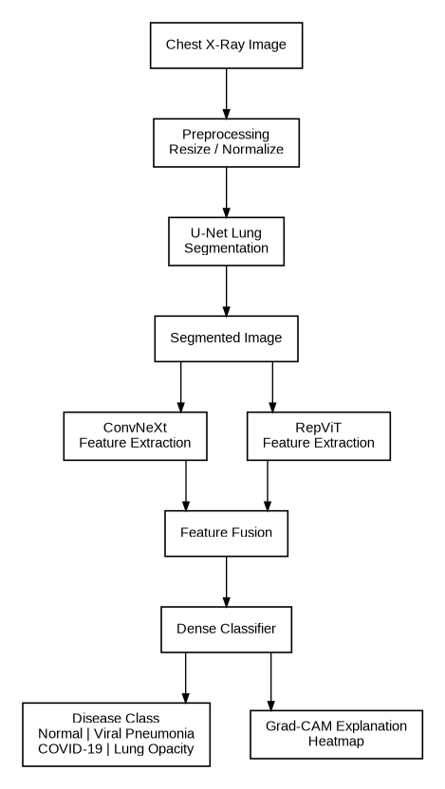
System Architecture

Slide 13
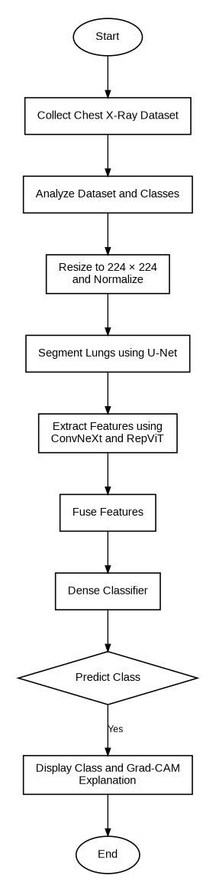
System Flowchart

Slide 14
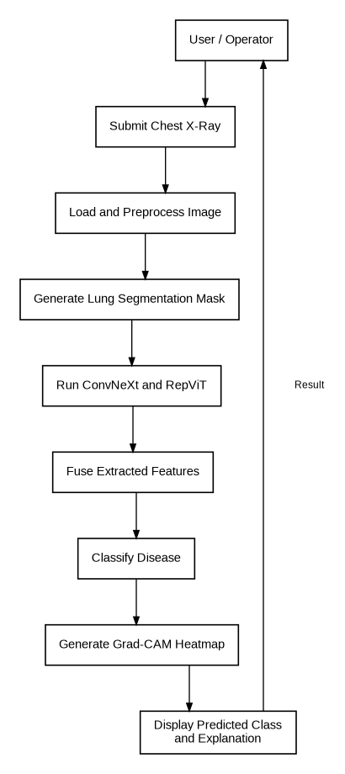
Behavioural Design

Slide 15
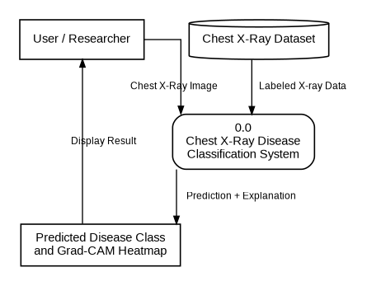
Data Flow Diagram

Slide 16
Implementation
Dataset Collection: The COVID-19 Radiography Database containing chest X-ray images from four classes — COVID-19, Normal, Viral Pneumonia, and Lung Opacity was collected and prepared for multi-class classification.
Dataset Analysis: The dataset structure, class distribution, image dimensions, and class-wise image availability were analyzed. The dataset was balanced to provide suitable samples for model training and evaluation.
Data Preprocessing: The chest X-ray images were resized to 224 × 224 pixels and normalized to suitable pixel-value ranges before model training.
U-Net Lung Segmentation: A U-Net model was implemented to segment the lung regions from chest X-ray images. The segmentation masks were generated and applied to the X-ray images to focus the classification models on the relevant lung regions while reducing irrelevant background information.

Slide 17
References
J. Du and J. Yang, "Classification of Chest X-ray Images (Pneumonia) Based on ResNet and Grad-CAM," 2023.
M. K. U. Ahamed et al., "DTLCx: An Improved ResNet Architecture to Classify Normal and Conventional Pneumonia Cases from COVID-19 Instances," Diagnostics, 2023.
A. Mabrouk et al., "Pneumonia Detection on Chest X-ray Images Using Ensemble of Deep Convolutional Neural Networks," 2023.
Jalal Rabbah, Mohammed Ridouani, and Larbi Hassouni, "Improving Pneumonia Diagnosis with High-Accuracy CNN-Based Chest X-ray Image Classification and Integrated Gradient," Biomedical Signal Processing and Control, vol. 101, Art. no. 107239, 2025.

Slide 18
THANK YOU

